Slide 1

I numeri dell’obesità oggi e le ricadute socio-sanitarie
alcune
nell’adulto
Simona Bo

Slide 2
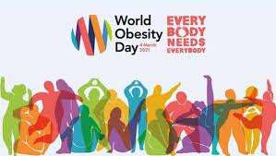
PREVALENZA DI OBESITA’

Slide 3
Current Obesity Reports (2023) 12:514–527

Slide 4

Worldwide trends in underweight and obesity from 1990 to 2022: a pooled analysis of 3663 population representative studies with 222 million children, adolescents, and adults
NCD Risk Factor Collaboration (NCD-RisC)*
1990
2022

Slide 5

1990
2022

Slide 6
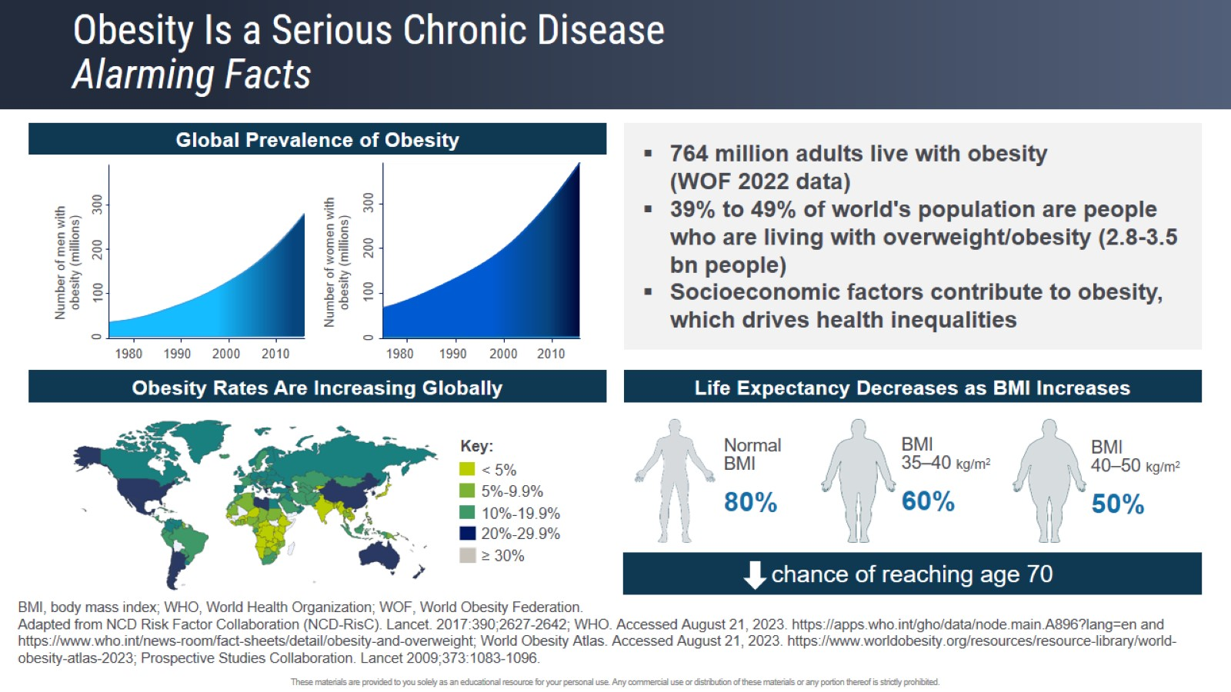
Obesity Is a Serious Chronic Disease
Alarming Facts

Slide 9
Temporal trends in obesity defined by the relative fat mass (RFM) index among adults in the United States from 1999 to 2020: a population-based study
BMJ Open 2023;13:e071295.

Slide 10
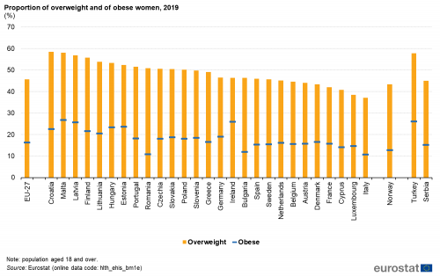

Slide 11
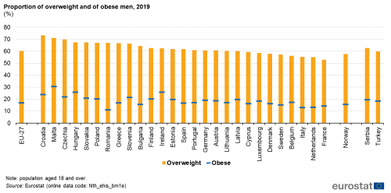

Slide 12
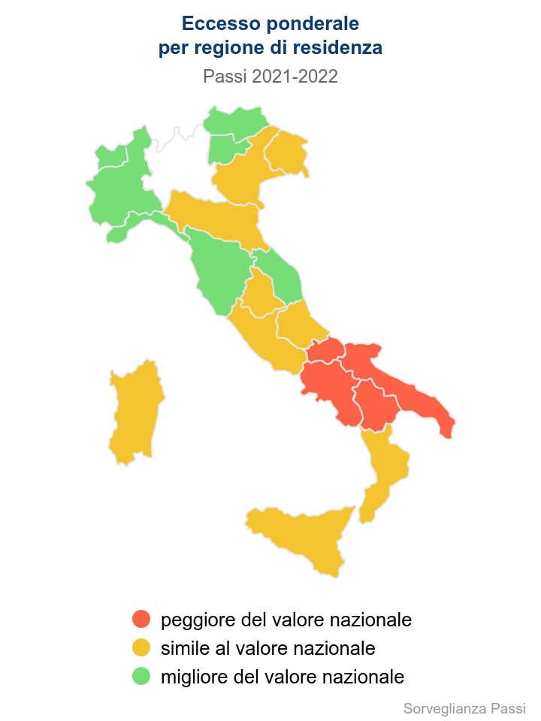
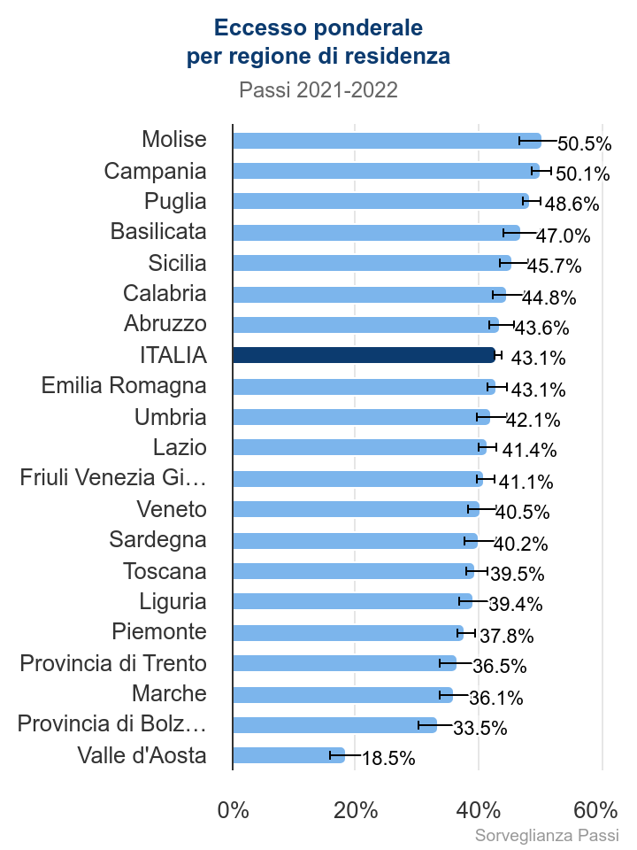

Slide 13

Anno 2022 | sottopeso | normopeso | sovrappeso | obesità
18-24 anni | 9 | 70 | 17.4 | 3.6
25-34 anni | 5.3 | 64.8 | 24 | 5.9
35-44 anni | 3.1 | 55.2 | 32.3 | 9.5
45-54 anni | 2.2 | 49 | 36.7 | 12.1
55-59 anni | 1.9 | 45.8 | 38.2 | 14.2
60-64 anni | 1.4 | 43.2 | 41.8 | 13.6
65-74 anni | 1.4 | 39.7 | 42.3 | 16.7
75 anni e più | 2.6 | 41.9 | 42.2 | 13.3
18 anni e più | 3.1 | 50.6 | 35 | 11.4

Slide 14
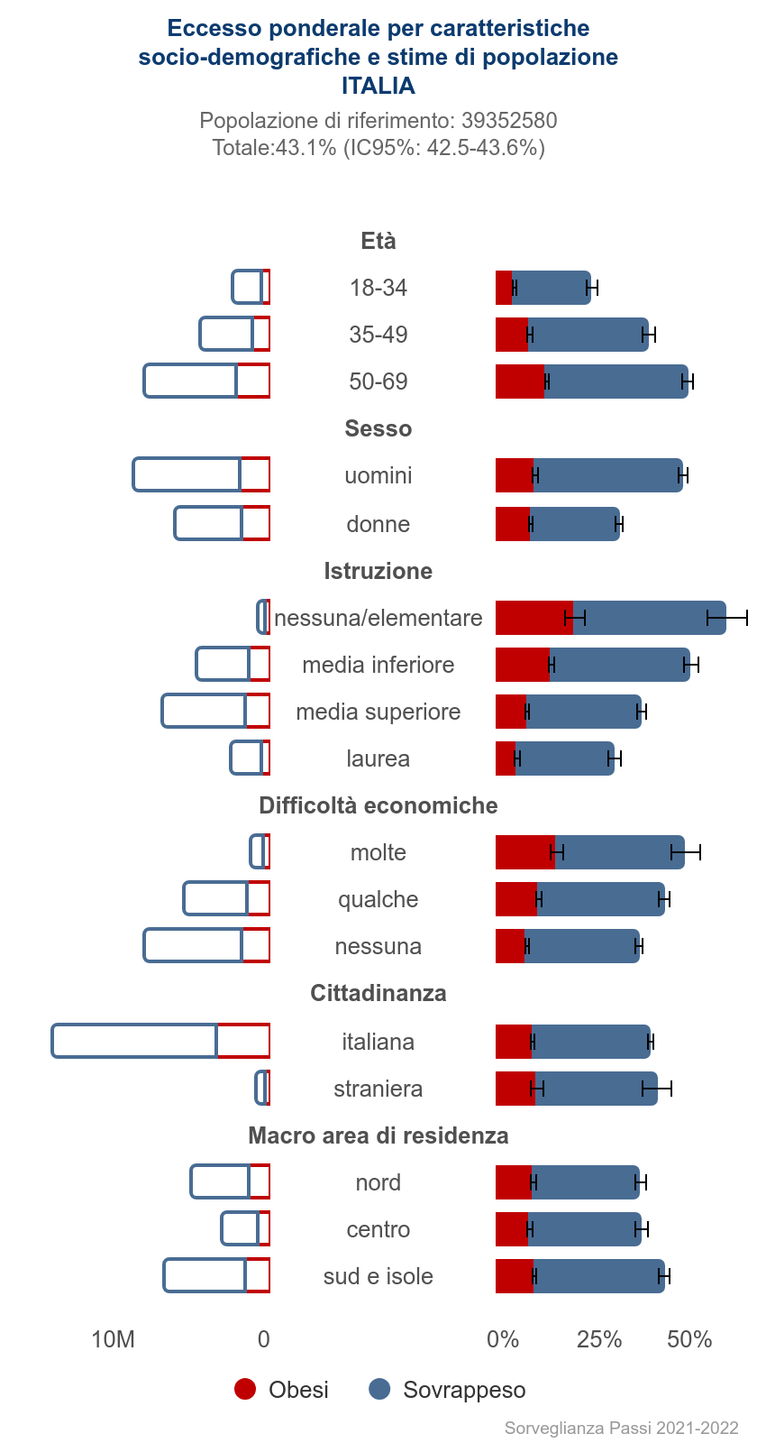
TITOLO DI STUDIO | sottopeso | normopeso | sovrappeso | obesità
8 anni e più licenza di scuola elementare, nessun titolo di studio licenza di scuola media diploma laurea e post-laurea
 | 2.2 | 37.4 | 42.9 | 17.5
 | 2.5 | 44.8 | 38.5 | 14.2
 | 3.2 | 54.5 | 33 | 9.4
 | 4.8 | 61.3 | 27.5 | 6.4
in altra condizione | 3.7 | 37.5 | 38.6 | 20.2
casalinga-o | 2.6 | 48.9 | 33.8 | 14.7
ritirato-a dal lavoro | 2 | 40.4 | 43.2 | 14.3
disoccupato | 3.9 | 50.6 | 33.2 | 12.3
lavoratore in proprio, coadiuvante familiare, co.co.co. | 2.2 | 47.7 | 38.6 | 11.5
totale | 3.1 | 50.6 | 35 | 11.4
operaio, apprendista | 2.2 | 49.6 | 37.3 | 11
occupato | 2.8 | 53.5 | 34.3 | 9.4
dirigenti, imprenditori, liberi professionisti | 2.4 | 53 | 36.5 | 8.1
direttivo, quadro, impiegato | 3.5 | 58.6 | 29.8 | 8
in cerca di prima occupazione | 4.5 | 60.9 | 26.6 | 8
studente | 10 | 72.6 | 14.6 | 2.9

Slide 15
We found that obesity rates among
the wealthiest decile were relatively stable with increasing national wealth, and the changing gradient was largely due to increasing obesity prevalence among poorer populations (3.5% [95% uncertainty interval: 0.0%–8.3%] to 14.3% [9.7%–19.0%]).
Our sample used 182 Demographic and Health Surveys and World Health Surveys (n=2.24 million respondents) from 1995 to 2016.
PLoS Med 16(11): e1002968

Slide 16
Rising rural body-mass index is the main driver of
the global obesity epidemic in adults
NCD Risk Factor Collaboration (NCD-RisC)*
2 6 0 | N AT U RE | VO L 5 6 9 | 9 M AY 2 0 1 9

Slide 17
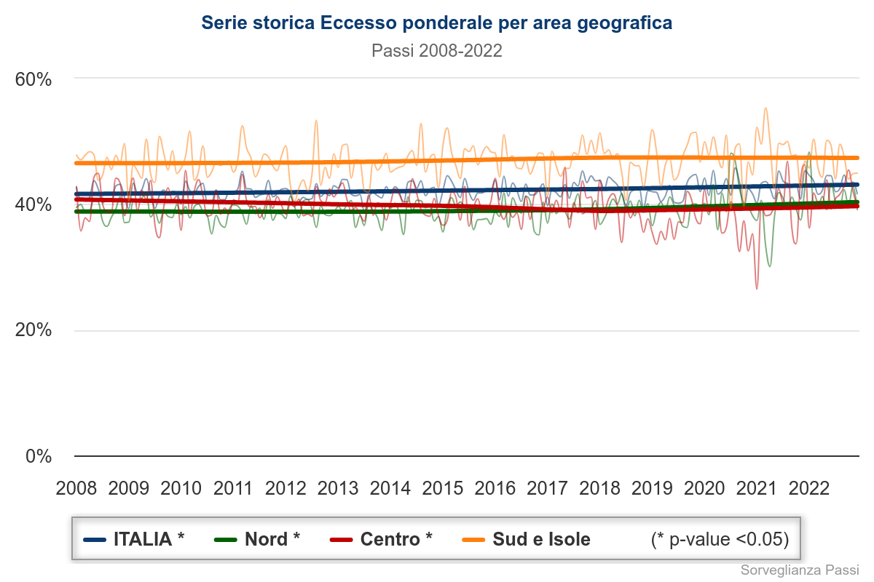

Slide 18
Obesity (Silver Spring). 2024;1–10.

Slide 19
Obesity (Silver Spring). 2024;1–10.

Slide 20
OBESITY RATE
SPORT FACILITIES

Slide 21
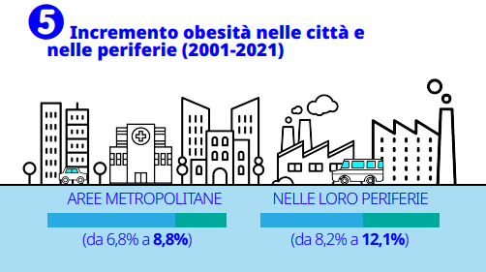
4th Italian Obesity Barometer Report 2022

Slide 22
Diabetes Metab Res Rev. 2024;e3748
Obesogenic environments:
It is time to re‐shape our cities

Slide 24


Slide 27
RICADUTE
SOCIO-ECONOMICO-
SANITARIE

Slide 28
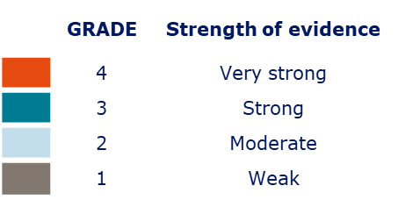
Obesity is associated with multiple complications
Urinary incontinence (including nocturia / stress urinary incontinence)
Heart transplant mortality
Kidney transplant – wound dehiscence
Barrett's esophagus
Glaucoma
Macular degeneration
Cataracts
CHF
Lung transplant – primary graft dysfunction
Heart transplant - rejection
Kidney transplant – new onset diabetes after transplant
Kidney transplant – delayed graft function
Renal Stones
Chronic rhosinustis
Meniere’s disease
Surgical wound infection
Type 2 diabetes
Kidney transplant – acite rejection
Kidney transplant – primary graft failure
Kidney transplant - mortality
Venous insufficiency
Allergic rhinitis
Nasal dyspnea
Subfertility
Lung transplant - mortality
CAD
Primary spontaneous cerebrospinal fluid rhinorrhea
Incisional hernia
EOM
ED
Gout
Benign prostatic hypertrophy
Fecal / Flatus incontinence
Overactive Bladder
Secondary hypogonadism (male)
Sexual dysfunction
IVF failure
Unemployment
Lack of sexual partners
Poor Semen Quality
HTN
VTE
Perceived vu
Low self-esteem
No close friends
Prostate
Cancers
Chronic widespread pain
Diverticulosis
Gallstones
NAFLD
Negative affect
Low gross individual earnings
Seb. dermatitis
GDM
Plantar Hypertension
Colorectal Polyps
Dementia
Fall
Left ventricular dilation
Congenital abnormality in newborn
Gestational hypertension
Hyperlipidemia
Frequent headaches (non-migraine)
Low HDL
Gallbladder Polyps
Esophageal Cancer
HLD
Left atrial enlargement
Stroke angina
Anti-phospholipid syndrome
Pre-diabetes
All cause mortality
Pancreatic Cancers
HCC
Size of circle reflects number of articles
Pre-mature delivery/
pre-term delivery
Thyroid issues during pregnancy or postpartum
ICD complications
Insulin resistance
Fibromyalgia
Peripheral artery disease
Emphysema, chronic bronchitis or obstructive pulmonary disease
End-stage renal failure on dialysis -mortality
Impaired physical function/mobility
Miscarriage
Postpartum hemorrhage
Myocardial Infarction
Hyperlipidemia
Congestive heart failure
Pressure ulcer – long stay nursing home residents
Multiple Sclerosis
Rheumatoid arthritis (including worse prognosis with more disability)
Preeclampsia
Menstrual irregularities
Sudden Cardiac Death
Migraine Headaches
Stent thrombosis
Stroke (ischemic, hemorrhagic, incident and recurrent)
Renal
Cancers
MM
Stomach Cancer
Ovarian Cancers
Prolonged labour
Unstable Angina
Renal
impairment
229+
complications affecting
EVERY organ system
and medical specialty
Sepsis during pregnancy or puerperium (including UTI)
Premenstrual syndrome
Post-epidural hypertension
Perianal rupture
Foetal Death
Hypertruglyceridemia
Elevated LDL
Metabolic syndrome
Type 2 diabetes mortality
Chronic kidney disease/End-stage renal failure
Hepatitis C
Carcinoid Tumors
Birth asphyxia
Infant mortality
Peripheral oedema
Failed labour induction
Albuminuria/Proteinuria
Cerebral atrophy
Shoulder dystocia
Offspring Obesity
Cervical incompetence
polyhydramnios
Eclampsia
Instrumental delivery (inc. forceps, vacuum)
Low Apgar score in the newborn
Heart failure incident
Diastolic dysfunction
Frailty
Thyroid Cancer
Gallbladder Cancers
Urinary
Bladder Cancers
Melanoma
Adverse fetal outcomes at delivery
Epidural
analgesia
Neonatal CBS
Postural instability / incomplete recovery step
Hiatal Hernia
Anxiety
Depression
Altered breast milk
Feeding problems of newborn
UTI during pregnancy and postpartum
Premature rupture of membrane
Placental abruption
Newborn % body fat >90th percentile
Neonatal seizure
Cirrhosis
Asthma
Stroke (mortality)
Pancreatitis
Paired
Uterine Cancers
Breast Cancers
This is illegible, I am writing txt so it appears similar to the original image.
Post-dates
Hyaline membrane disease
Failed trial of labour
Fetal heart rate deceleration
NICU admission
Macrosomia
Chronic insomnia
Manic episode
Anti-social personality disorder
Endometrial
Cancers
Non-Hodgkin Lymphoma
Bacterial sepsis of newborn
A-fib
Low general health
Avoidant Personality
Large-for-gestational age
Post-delivery wound complications (inc. C-section wound, wound infection, poor wound healing)
Child hospital admissions in the first 5 years of life
Birth injury (inc. to the peripheral nervous system and to the skeleton)
Respiratory problems in the newborn
GERD
Left ventricular hypertrophy
Multimorbidity
Osteoarthritis hip
Poor response to surgery after orthopedic injury
Neonatal hypoglycemia / Inc. C-peptide…
Sciatica / LBP
Colorectal Cancers
Induction of labour
C-section (incl. elective and emergency)
Lymphoedema
Fatigue (lack of energy)
Higher risk of heat stroke
Osteoporotic fracture
Higher mortality after burn (BMI>35)
Illegible
Hirsutism
Elephantiasis
Onychomycosis
Tooth loss / edentulism
Gingivitis
Reduced life expectancy
Ipoor recovery after burn
Early failure after operative syndesmosis injuries
Low velocity / Spontaneous knee dislocation
Stria
Tinea Cruris
Stria
Pyoderma Gangrenosum
Bacterial Infections
Acne vulgaris
OA
Humerus fracture / Upper limb fracture
Spontaneous rupture of quadriceps tendons
Rotator cuff / Upper extremities tendinitis
Post-trauma multiple organ Failure/Mortality
Multiple Yeast Infections
Hidradenitis Suppurative
Acrochordons
Stria Cutis Distense
Stasis Changes
Cherry Hemangiomas
Folliculitis
Periodontitis
(including increased risk of periodontitis progression)
Neck, back, Knee pain or other joint poin
Multiple Bladder Infections
Keratosis Pilaris
Lychen Sclerosus
Seb. Keratosos
Ersypels
Intertrigo
Injury (Occupational/Sports/Unspecified) incl, sprains/strains
Alopecia
Skin tags
Hyperhidrosis
Acanthosis Nigricans
Ankle Fracture/lower limb fracture
A-fib, atrial fibrillation; CAD, coronary artery disease; CHF, congestive heart failure; ED, erectile dysfunction; EOM, eosinophilic otitis media; GDM, gestational diabetes mellitus; GERD, gastroesophageal reflux disease; HCC, hepatocellular carcinoma; HTN, hypertension; HLD, hyperlipidemia; MM, multiple myeloma; NAFLD, non-alcoholic fatty liver disease; OA, osteoarthritis; VTE, venous thromboembolism.
Horn et al. Postgrad Med 2022;134:359–75.
Notes:
[This slide is animated]
Obesity can lead to multiple complications, affecting many organs
There are more than 229 complications associated with obesity, impacting every organ system and medical specialty
The majority of these complications are strongly supported by evidence from published articles
References:
Horn et al. What is clinically relevant weight loss for your patients and how can it be achieved? A narrative review. Postgrad Med 2022;134(4):359–75.

Slide 29


Slide 30
Cancer Epidemiology 87 (2023) 102468

Slide 31
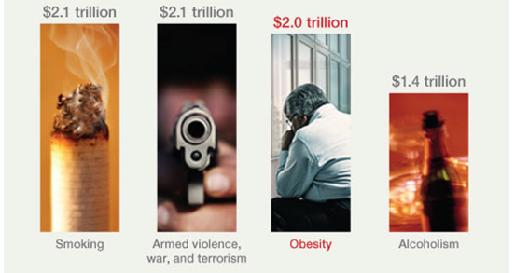
RICADUTE ECONOMICHE

Slide 32
Okunogbe A, et al. BMJ Global Health 2021;6:e006351

Slide 33
Okunogbe A, et al. BMJ Global Health 2021;6:e006351

Slide 34
Okunogbe A, et al. BMJ Global Health 2021;6:e006351

Slide 35
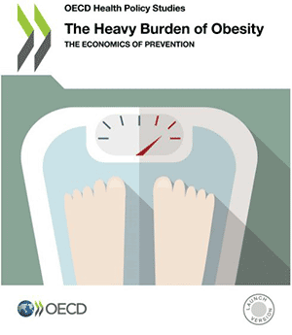
ORGANIZZAZIONE PER LA COOPERAZIONE E LO SVILUPPO ECONOMICO

Slide 37
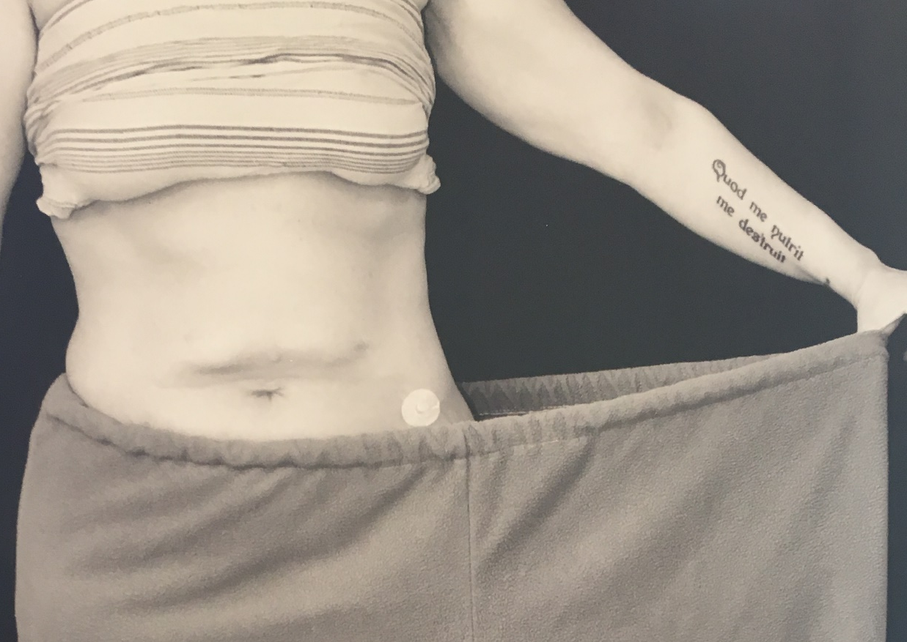

I costi legati a NON intraprendere azioni contro l’obesità sono enormi e non giustificati
L’epidemia di obesità è complessa e non ha soluzioni semplici
Le soluzioni da intraprendere devono tenere conto delle disparità socio-demografiche
Una singola azione (es. tassa sul junk food, sussidi per incoraggiare l’esercizio) non è sufficiente
È necessario attuare politiche di prevenzione a livello di intere comunità (e non selettive)

